Slide 1


“The happiness of your life depends upon the quality of your thoughts.”
― Marcus Aurelius
“Happiness is when your life fulfills your needs.”
“The most important thing is to enjoy your life—to be happy—it's all that matters.”
― Audrey Hepburn
-- HappinessInternational
“Happiness is not something ready made. It comes from your own actions.”
― Dalai Lama XIV
“Happiness is a warm puppy.”
― Charles M. Schulz
But what do you need to be happy?
“Happiness is when what you think, what you say, and what you do are in harmony.”
― Mahatma Gandhi

Slide 2
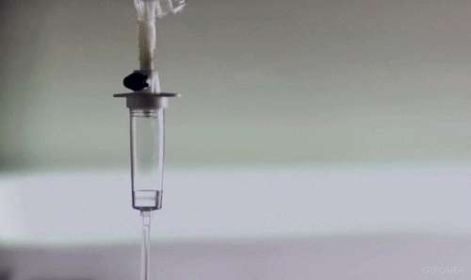
Health?

Slide 3
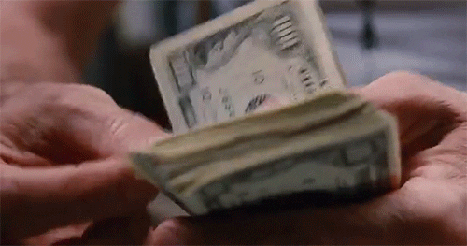
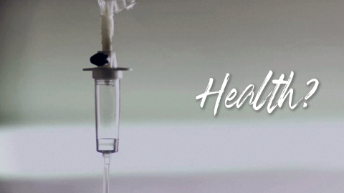
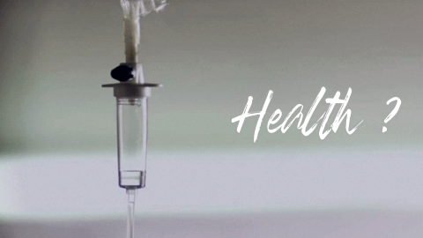
Money?

Slide 4
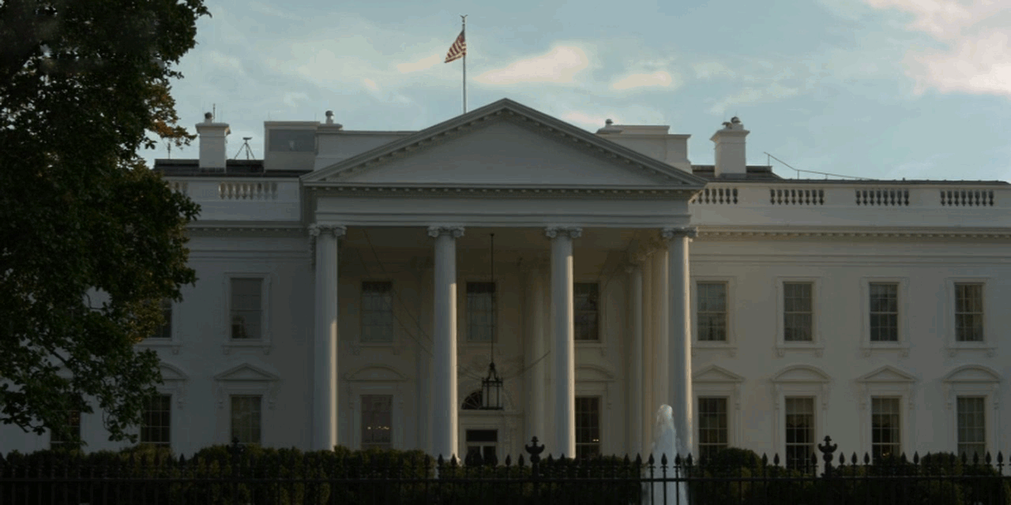
Politics?

Slide 5
Are you happy?

Slide 6

– Sources –
World Happiness Report
– Kaggle
World Happiness Data
– Kaggle
Human Happiness Indicators
– Kaggle
Social Progress and Happiness
– Kaggle
Personal well-being estimates by age and sex
– Office for National Statistics – U.K.
Happiness and Alcohol Consumption
– Kaggle

Slide 7
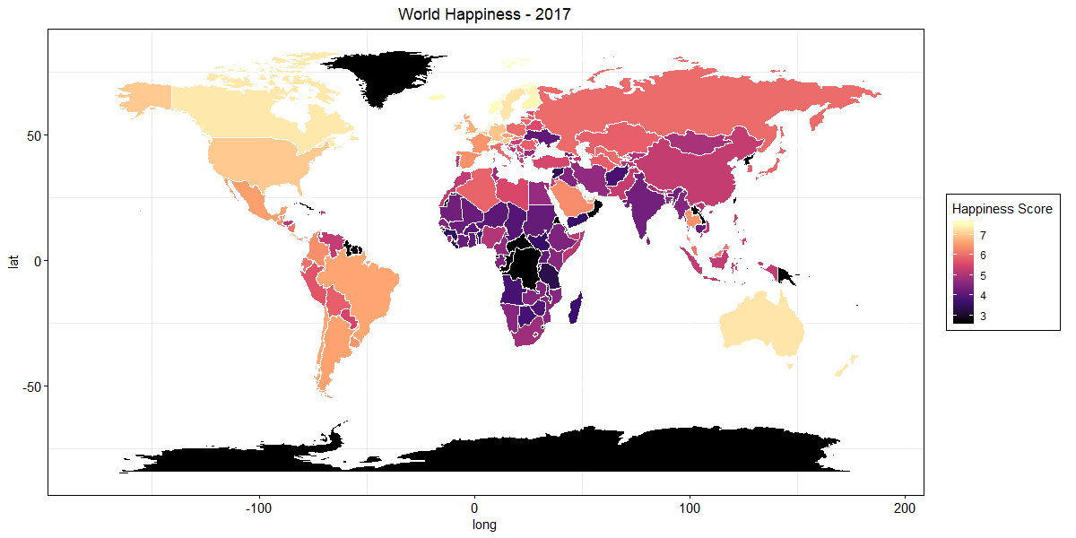

Slide 8
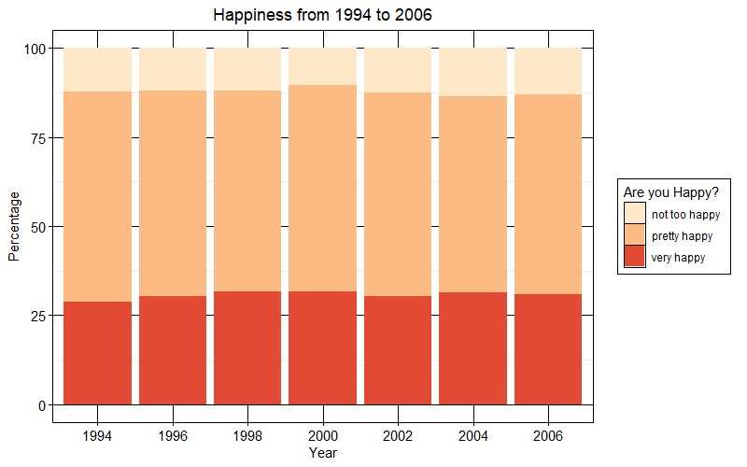
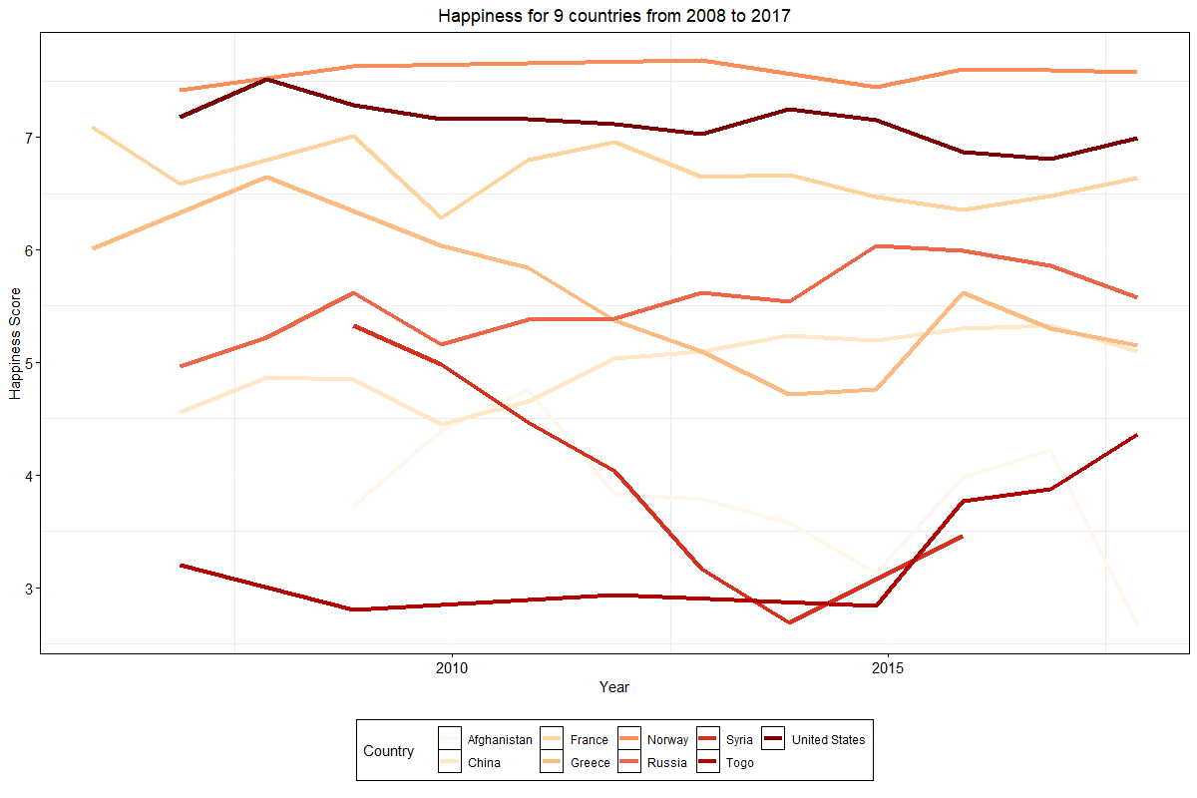
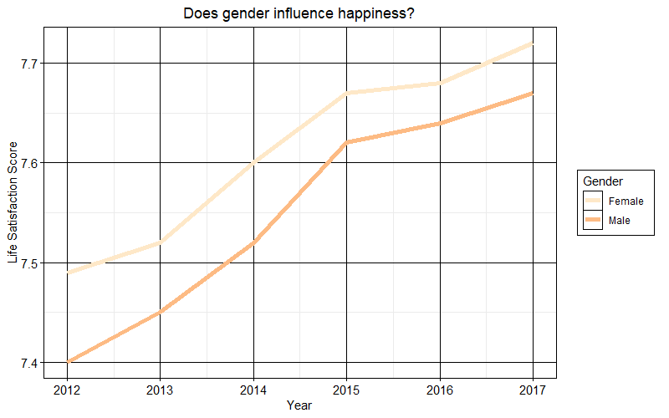
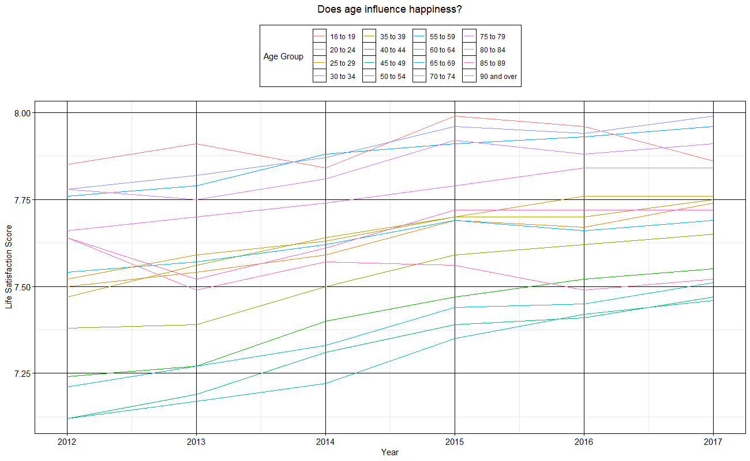

Slide 9
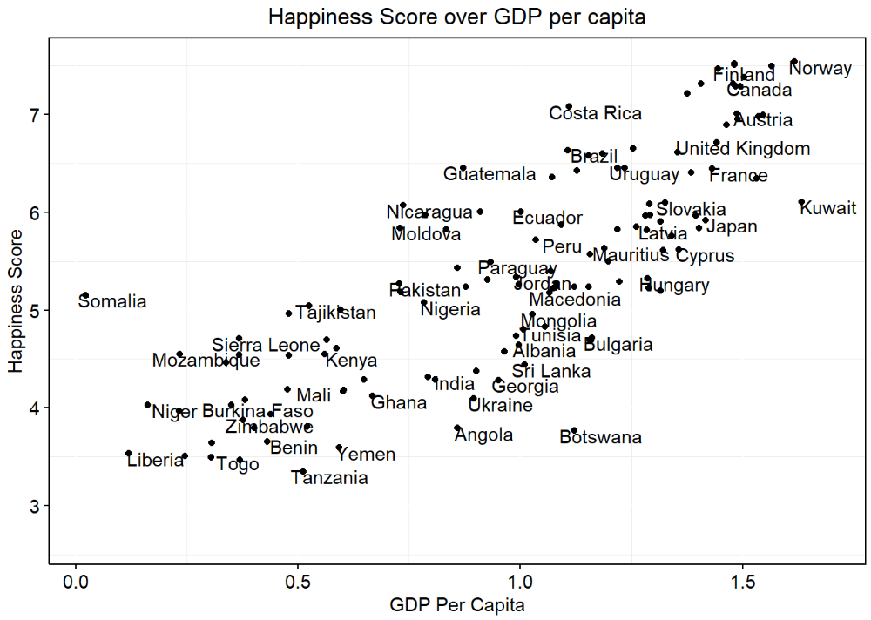
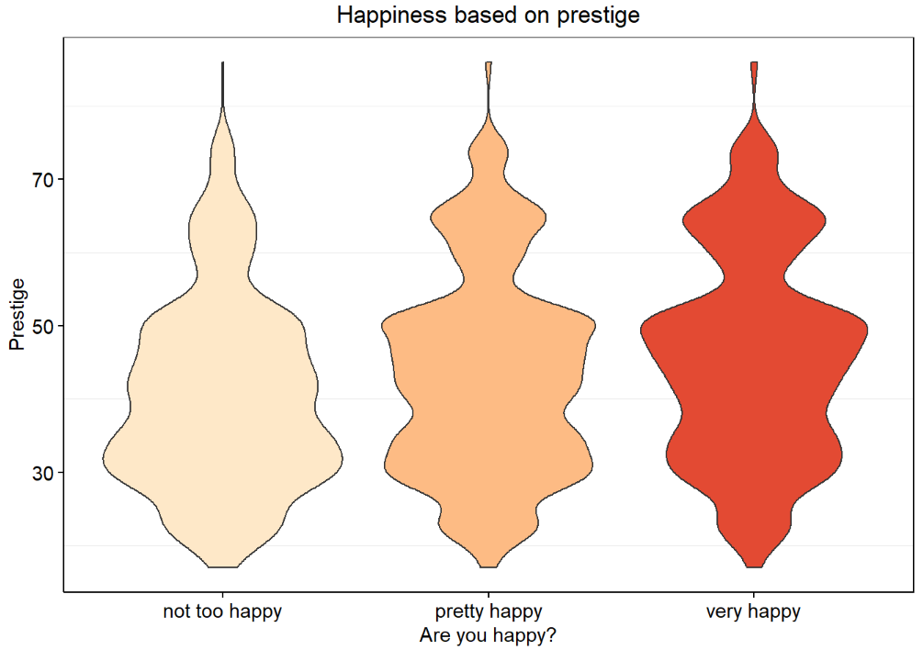
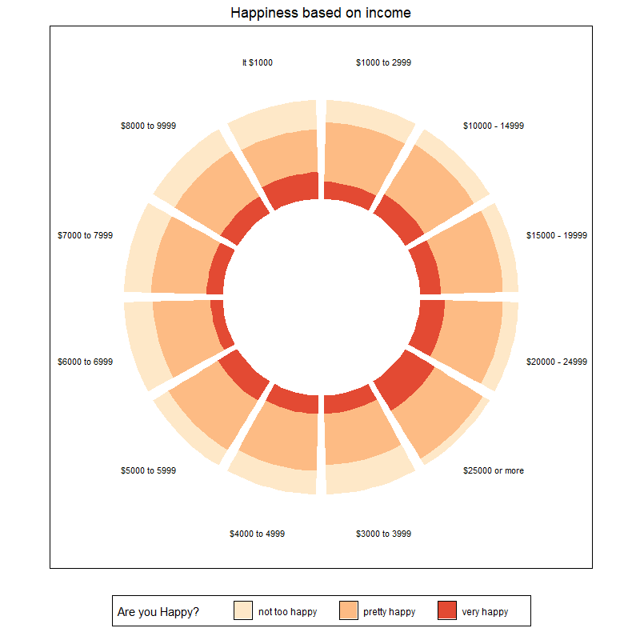
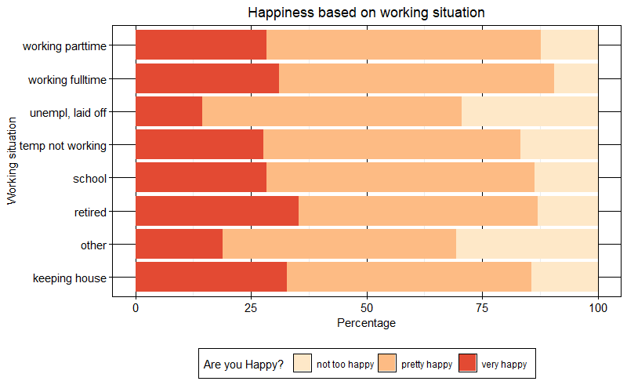

Slide 10
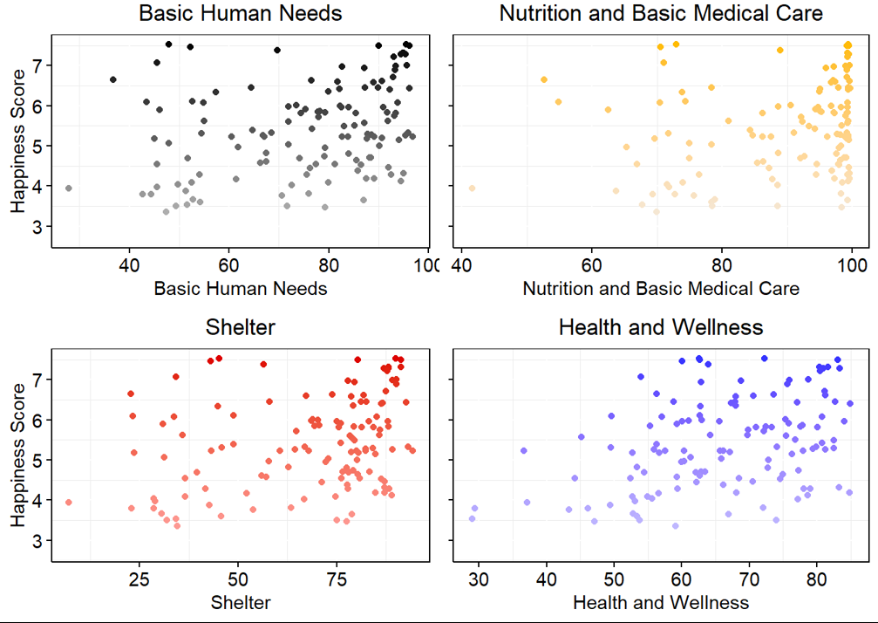
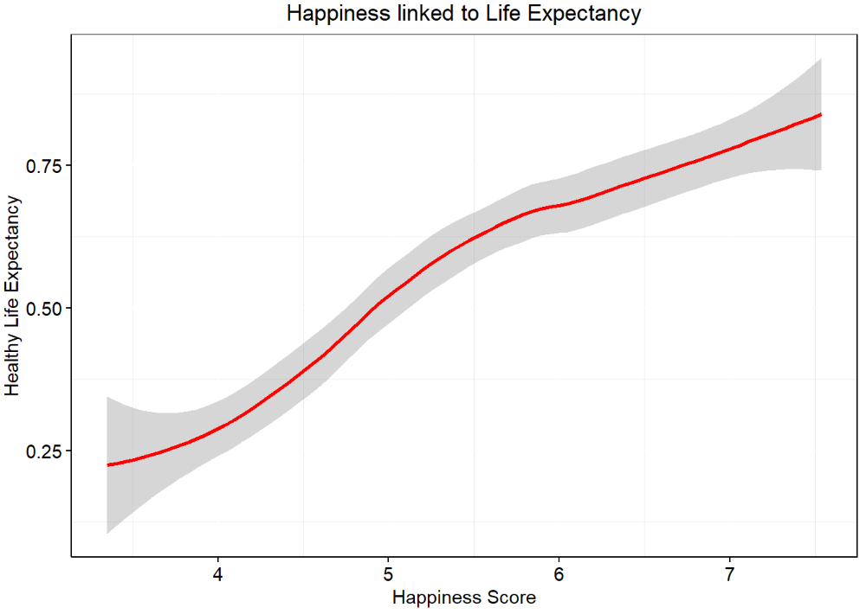

Slide 11
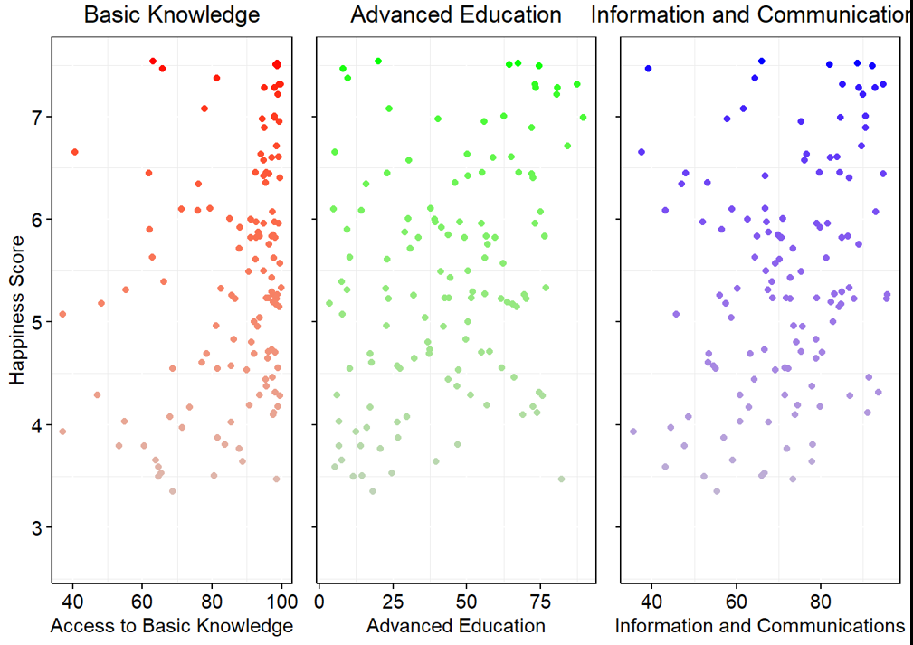

Slide 12
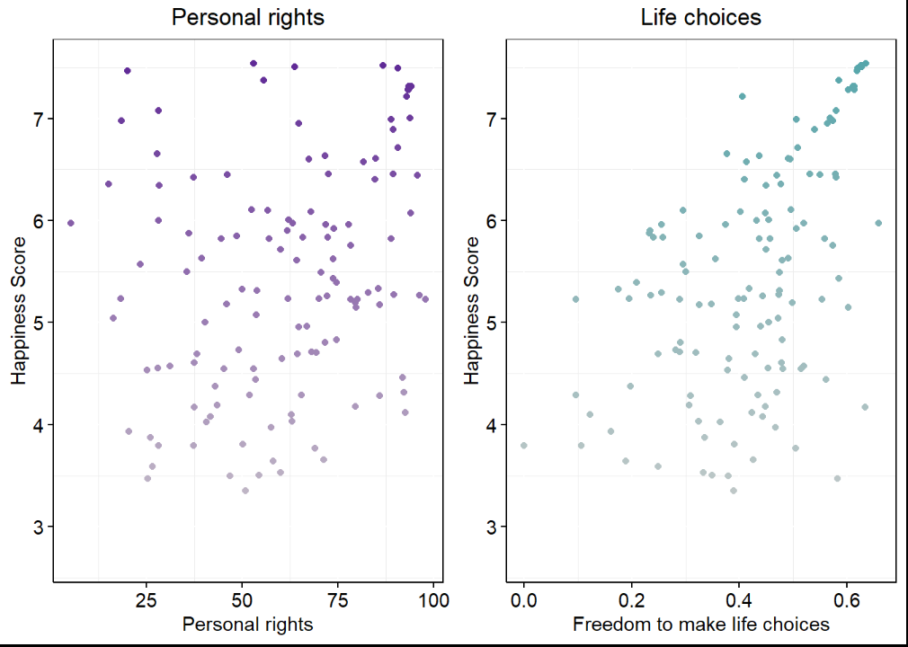
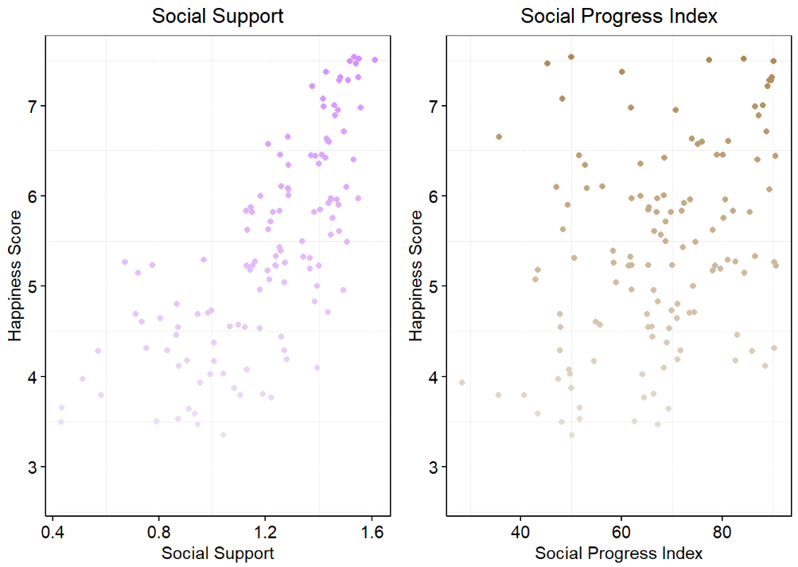

Slide 13
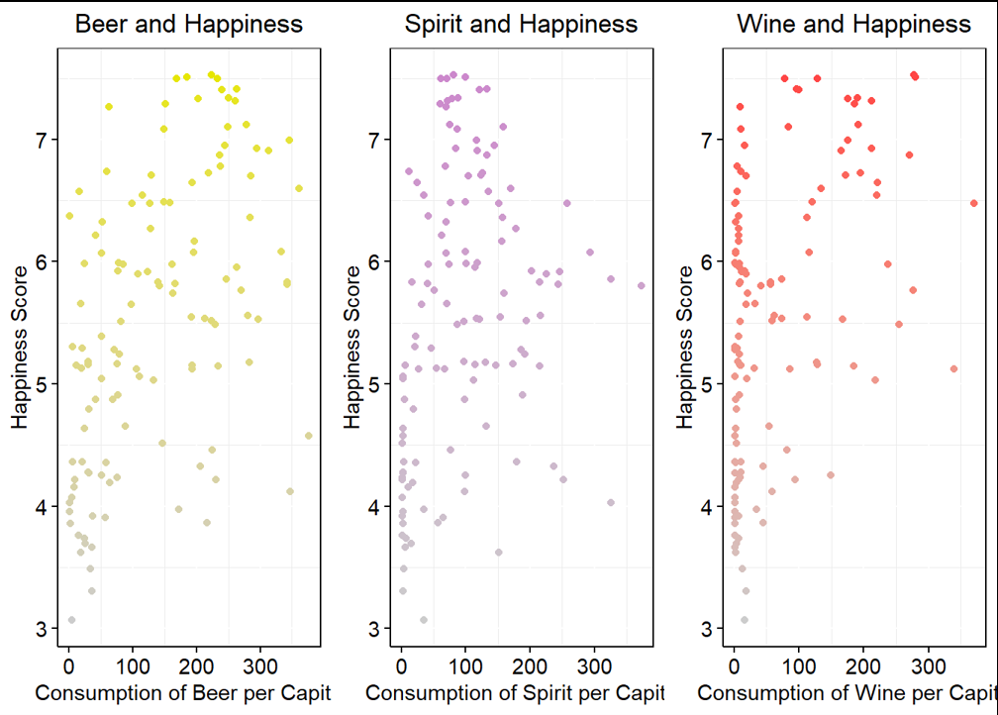

Slide 14
Are you happy?

